Slide 1
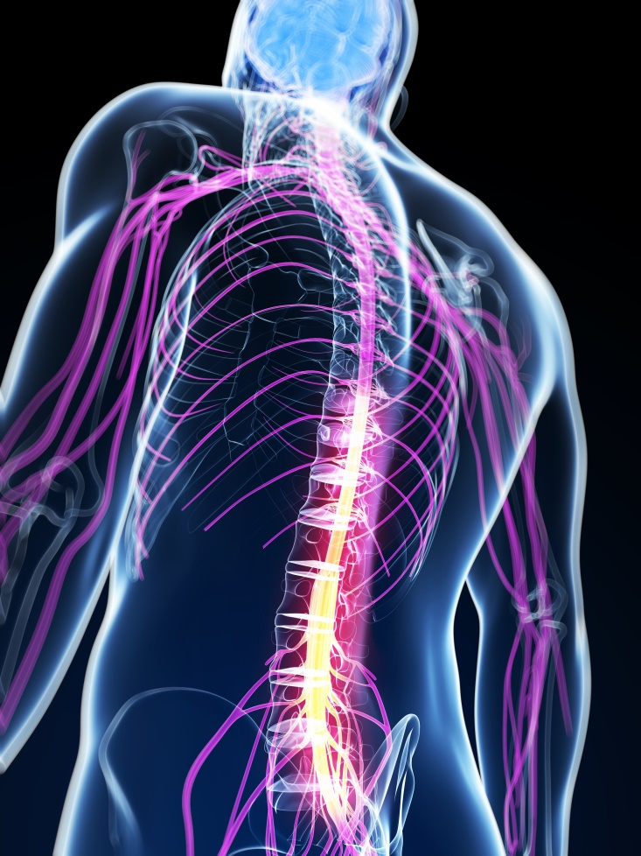
ANATOMY OF SPINAL CORD
DR OMOTAYO H A
Notes:
‹#›

Slide 2
Resources
  Human Anatomy & Physiology
    Elaine Marieb
  Introduction to Human Body
    Gerard Tortora
  Human Brain
    John Nolte
  Google
Notes:
‹#›

Slide 3
OBJECTIVES
At the end of the lecture, students should be able to:
  Describe the external anatomy of the spinal cord.
  Describe the internal anatomy of the spinal cord.
  Describe the spinal nerves: formation, branches and distribution via plexuses.
  Describe the meninges of the spinal cord.
  Define a reflex and reflex arc, and describe the components of the reflex arc.
Notes:
‹#›

Slide 4
REVIEW
Notes:
‹#›

Slide 5
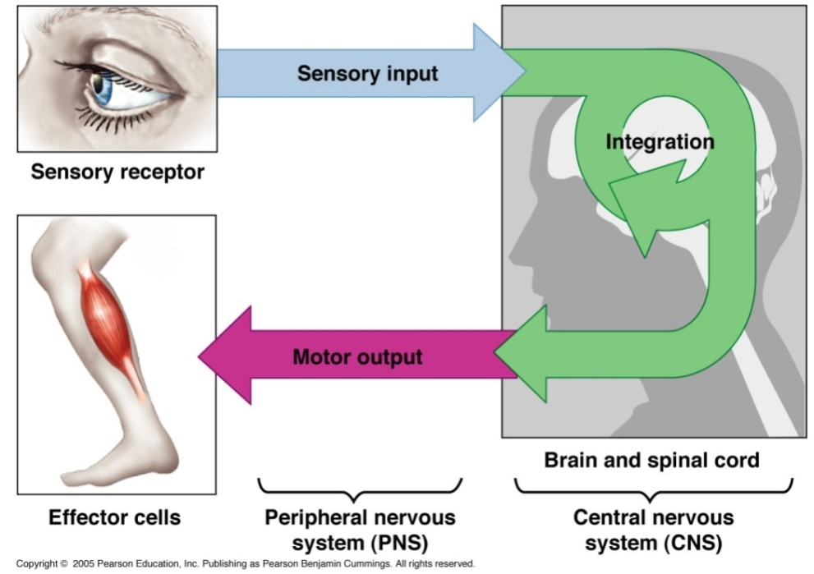
FUNCTIONS
The nervous system has 3 functions:
Collection of Sensory Input
  Identifies changes occurring inside and outside the body by using sensory receptors. These changes are called stimuli
  Integration
  Processes, analyses & interprets these changes and makes decisions
  Motor Output
  It then effects a response by activating muscles or glands (effectors) via motor output
Notes:
‹#›

Slide 6
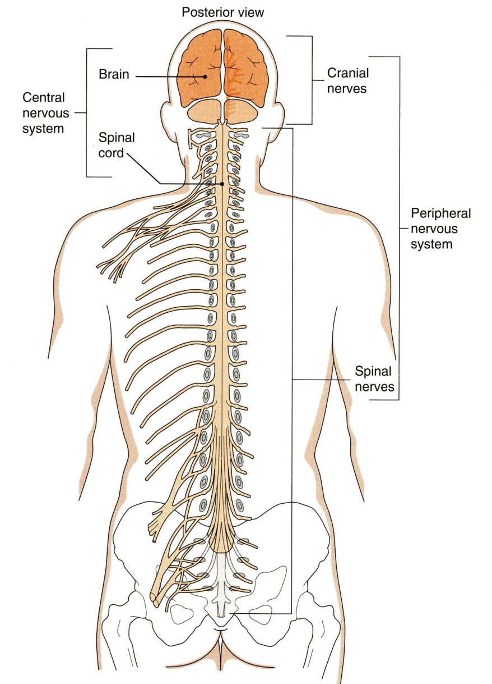
ORGANIZATION
STRUCTURAL
Central Nervous System (CNS)
  Brain & Spinal Cord
Peripheral Nervous System (PNS)
  Nerves & Ganglia
    Cranial nerves
    Spinal nerves
Notes:
‹#›

Slide 7
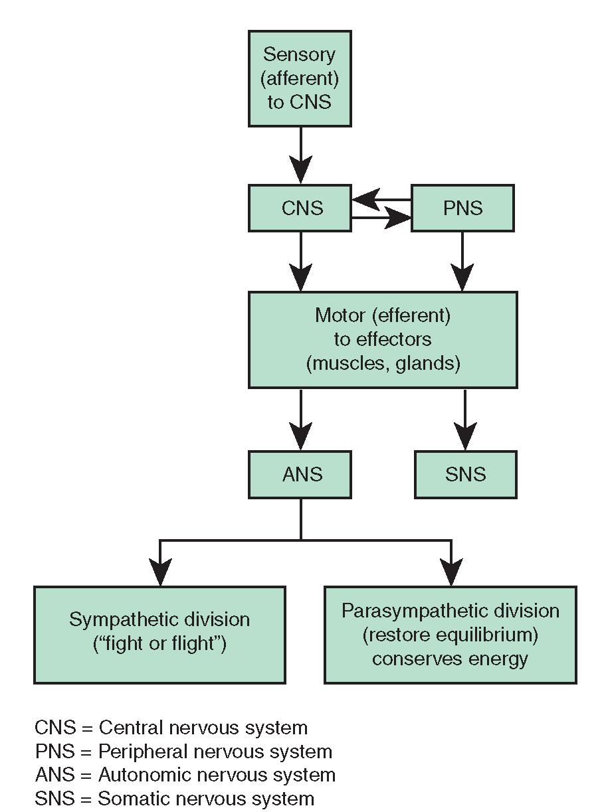
ORGANIZATION
FUNCTIONAL
Sensory Division (Afferent)
Motor Division (Efferent)
  Autonomic
  Somatic
Notes:
‹#›

Slide 8
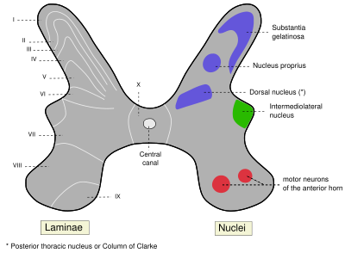
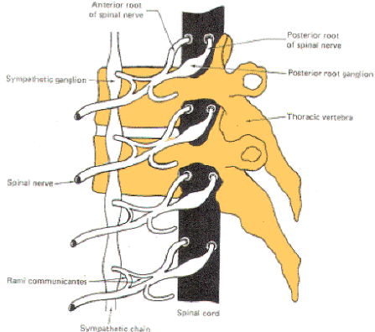
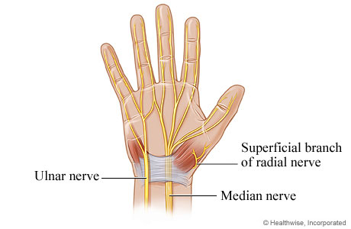
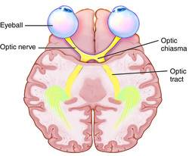
Ganglion
A group of neurons outside the CNS
Nucleus
A group of neurons within the CNS
Nerve
A group of nerve fibers (axons) outside the CNS
Tract
A group of nerve fibers (axons) within the CNS
Notes:
‹#›

Slide 9
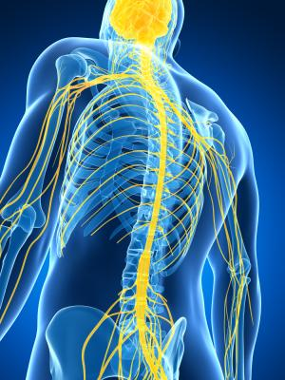
SPINAL CORD
The main pathway for information connecting the brain and peripheral nervous system.
It is elongated, cylindrical, suspended in the vertebral canal and protected by vertebrae
Surrounded by the meninges and cerebrospinal fluid (CSF).
The primary function of spinal cord is a transmission of neural signals between the brain and the rest of the body.
  Sensory
  Motor
  Local reflexes
Notes:
‹#›

Slide 10
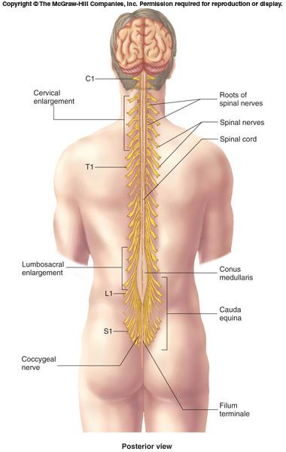
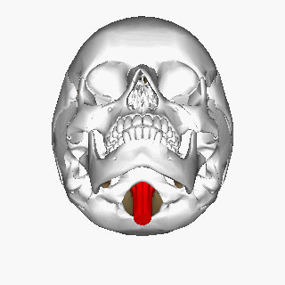
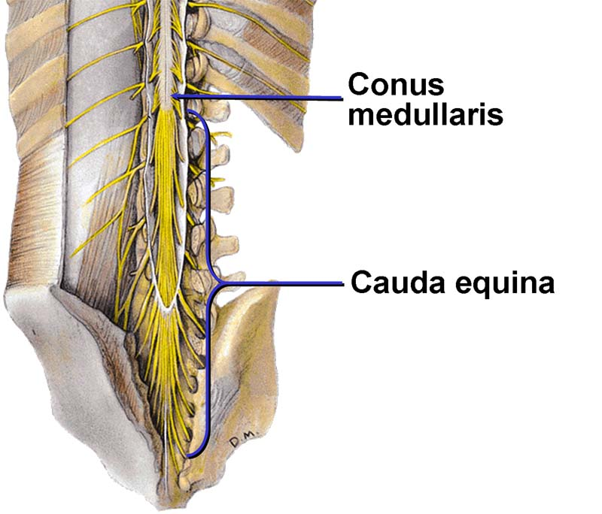
SPINAL CORD
Extends from foramen magnum to second lumbar vertebra.
Continuous above with the medulla oblongata.
The tapered inferior end forms conus medullaris.
It is connected to the coccyx by a non-neuronal cord called Filum Terminale.
Notes:
‹#›

Slide 11
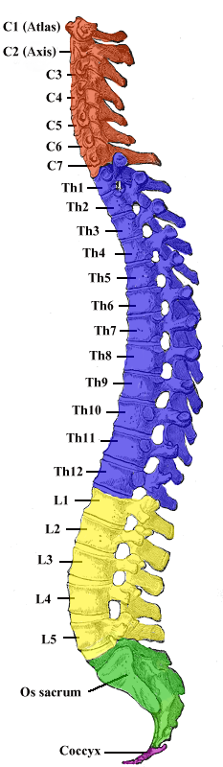
SPINAL CORD
Gives rise to 31 pairs of spinal nerves
The bundle of spinal nerves extending inferiorly from lumbosacral enlargement and conus medullaris surround the filum terminale and form cauda equina
Segmented
  8 Cervical
  12 Thoracic
  5 Lumbar
  5 Sacral
  1 Coccygeal
Has two enlargements:
  Cervical Enlargement: supplies upper limbs.
  Lumbosacral Enlargement: supplies lower limbs.
Notes:
‹#›

Slide 12
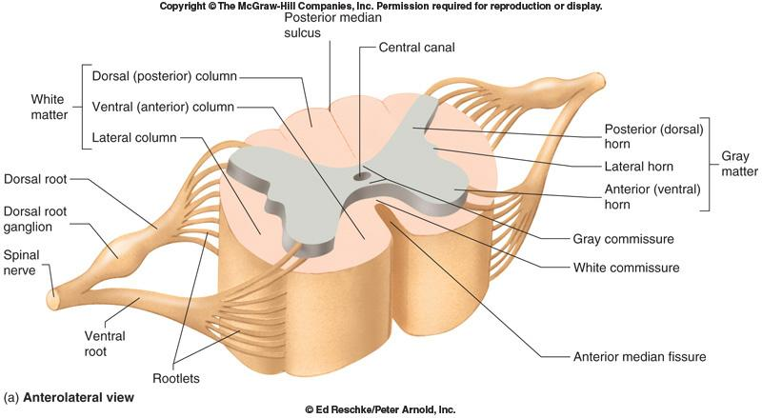
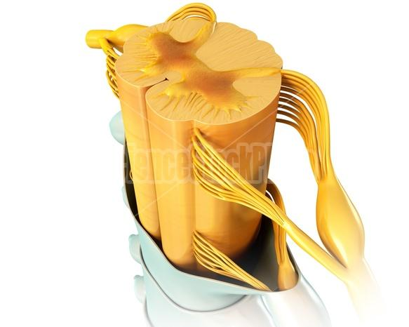
CROSS SECTION OF SPINAL CORD
The spinal cord is incompletely divided into two equal parts, anteriorly by a short, shallow median fissure and posteriorly by a deep narrow septum, the posterior median sulcus.
Composed of grey matter in the center surrounded by white matter supported by neuroglia.
Commissures: connections between left and right halves
  Gray with central canal in the center
  White
Roots: spinal nerves arise as rootlets then combine to form roots
  Dorsal (posterior) root has a ganglion
  Ventral (anterior)
  Two roots merge laterally and form the spinal nerve
Notes:
‹#›

Slide 13
GREY MATTER
The arrangement of grey matter in the spinal cord resembles the shape of the letter H.
Having:
  two posterior
  two anterior
  two lateral horns/columns.
Consists of:
  nerve cell bodies and their processes
  neuroglia
  blood vessels
Notes:
‹#›

Slide 14
GREY MATTER
The nerve cells are multipolar, and are of THREE main categories:
Sensory neurons (Tract cells)
  receive impulses from the periphery of the body and whose axons constitute the ascending fasciculi of the white matter.
  located in the dorsal horns.
Lower motor neurons
  transmit impulses to the skeletal muscles.
  located in the ventral horns
    similar neurons in the lateral horn are the preganglionic neurons of the autonomic system.
Interneurons (connector neurons)
  linking sensory and motor neurons, at the same or different levels, which form spinal reflex arcs.
Notes:
‹#›

Slide 15
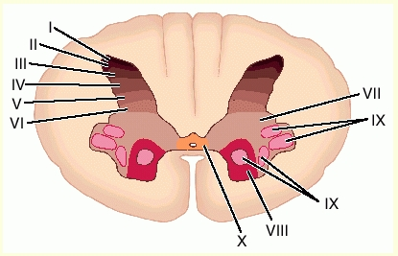
NEURONAL ARCHITECTURE OF
SPINAL GREY MATTER
Cells of the same type are clustered into groups, which occur in long columns
In transverse section, these columns appear as layers, especially within the dorsal horn
These layers are called the laminae of Rexed that are numbered by Roman numerals, starting from the tip of the dorsal horn and moving ventrally into the ventral horn.
The Rexed laminae comprise a system of ten layers of grey matter (I-X), identified in the early 1950s by Swedish neuroscientist.
Notes:
‹#›

Slide 16
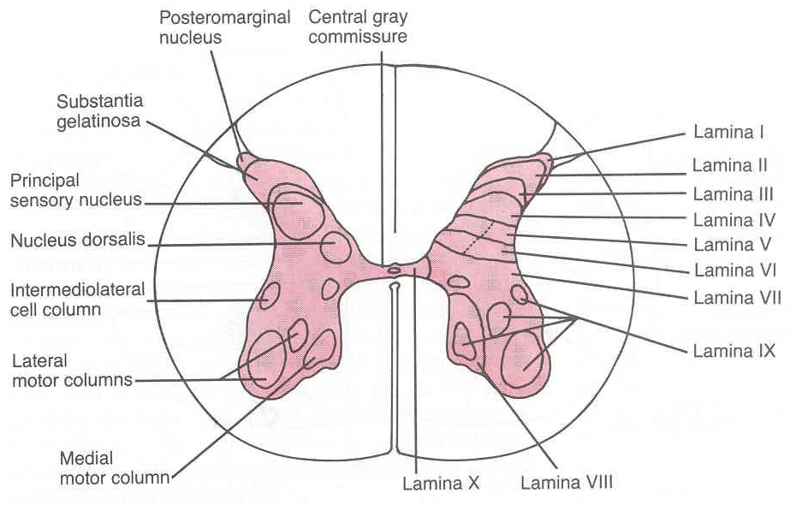
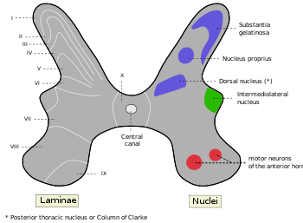
NERVE CELL GROUPS IN DORSAL HORN
Four main groups
Substantia Gelatinosa
Nucleus Proprius
Nucleus Dorsalis
  Clark’s column
  Nucleus thoracis
Visceral Afferent Nucleus
Notes:
‹#›

Slide 17
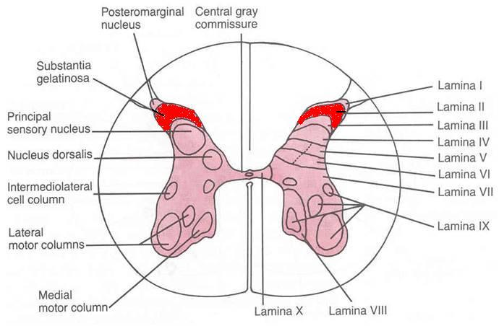
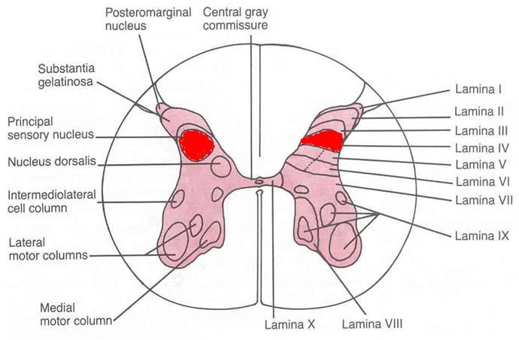
Substantia Gelatinosa
Rexed Laminae II
Located at the apex of the horn
Composed of large neurons
Extends throughout the length of spinal cord
Afferents: dorsal root fibers concerned with pain, temperature and touch
Nucleus Proprius
Rexed Lamina IV
Located anterior to substantia gelatinosa
Composed of large neurons
Extends throughout the length of spinal cord
Afferents: dorsal root fibers concerned with senses of position & movement (proprioception)
Notes:
‹#›

Slide 18
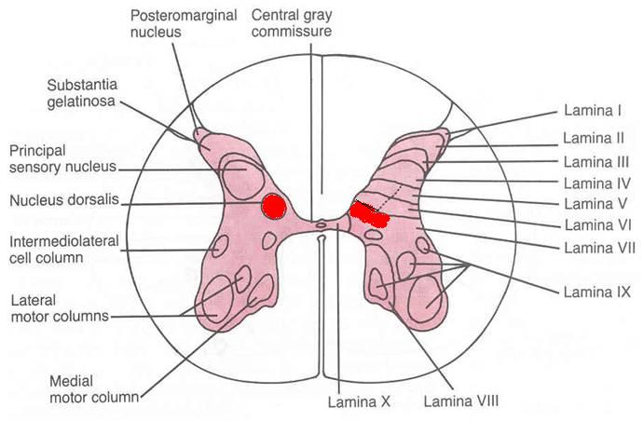
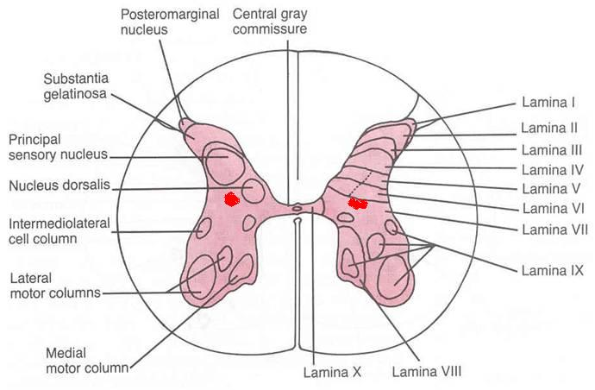
Nucleus Dorsalis (Clark’s column, Nucleus thoracis)
Rexed Lamina VII
Located at the base of dorsal horn
Composed mostly of large neurons
Extends from C8 to L3-4 segments
Associated with proprioceptive endings
Afferents: dorsal root fibers concerned with information from muscle spindles and tendon organs.
Visceral Afferent Nucleus
Rexed Lamina VII
Located lateral to nucleus dorsalis
Composed mostly of medium size neurons
Extends from T1 to L3 segments
Afferents: Visceral afferents
Notes:
‹#›

Slide 19
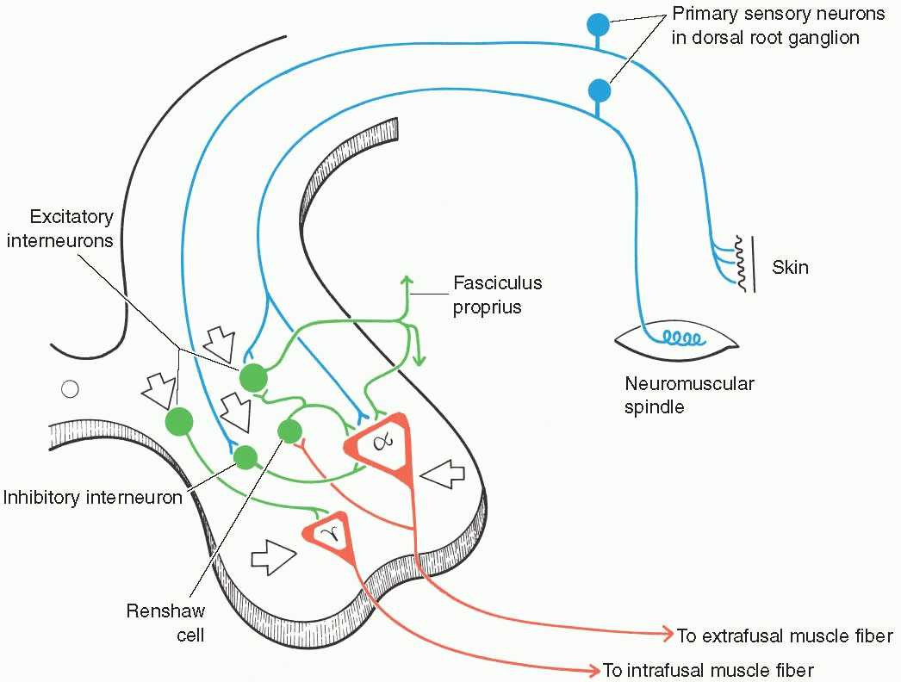
NERVE CELL GROUPS IN VENTRAL HORN
Motor neurons, also called lower motor neurons.
Notes:
‹#›

Slide 20
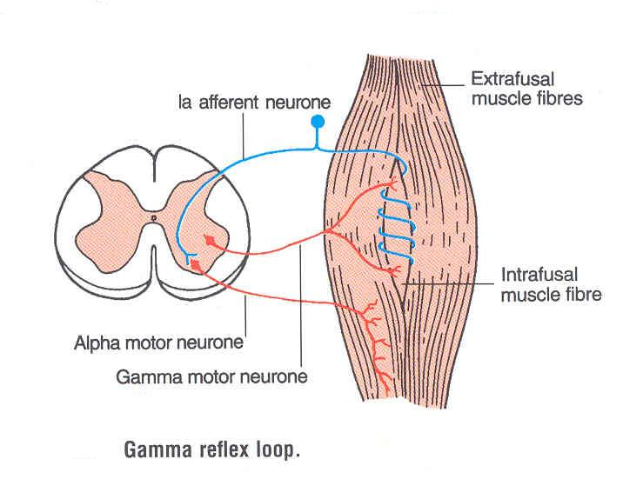
MOTOR NEURONS IN VENTRAL HORN
Are of Two types
Large multipolar cells
  whose axons pass out in the ventral roots of spinal nerves as alpha efferents which innervate extrafusal muscle fibers of skeletal muscles.
Less numerous smaller multipolar cells
  whose axons pass out in the ventral roots of spinal nerves as gamma efferents which innervate intrafusal muscle fibers of neuromuscular spindles
Both alpha and gamma motor neurons are under the influence of descending pathways from brain
Notes:
‹#›

Slide 21
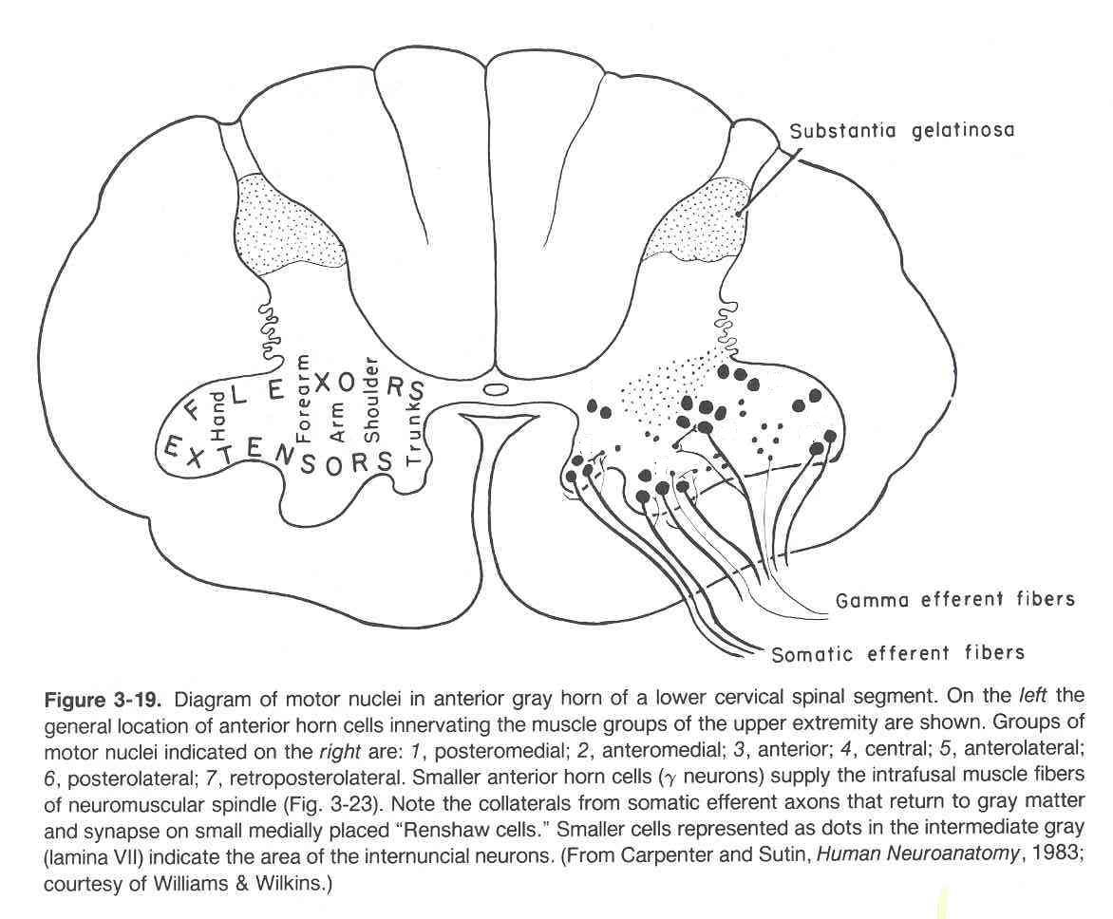
MOTOR NEURONS IN VENTRAL HORN
Motor neurons are organized in 3 groups:
Medial:
  Present in most segments, innervates muscles of neck and trunk (including intercostal and abdominal muscles)
Central:
  Smallest, present in some cervical (phrenic C3-5, spinal accessory C1-6) and lumbosacral (L2-S1) segments
Lateral:
  Present in cervical and lumbosacral segments, innervates muscles of the limbs
Neurons supplying flexor muscles are located dorsal to neurons for extensor muscles
Notes:
‹#›

Slide 22
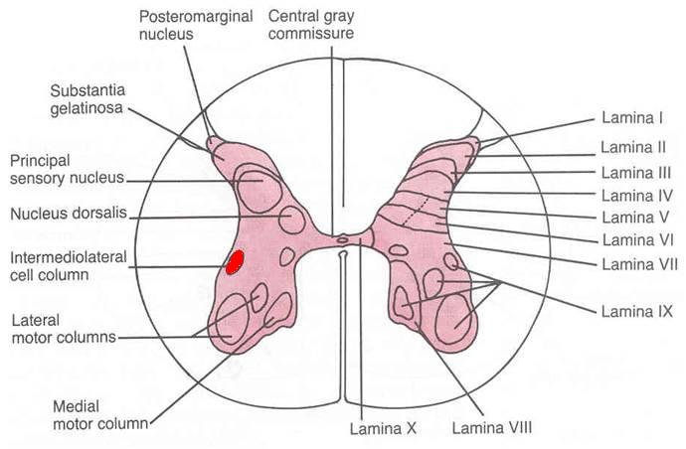
NERVE CELL GROUPS IN LATERAL HORN
Small Column composed of small neurons
  Extends from T1 to L2-3 segments:
    Give rise to preganglionic sympathetic fibers
  Extends from S2-4 segments:
    Give rise to preganglionic parasympathetic fibers
Notes:
‹#›

Slide 23
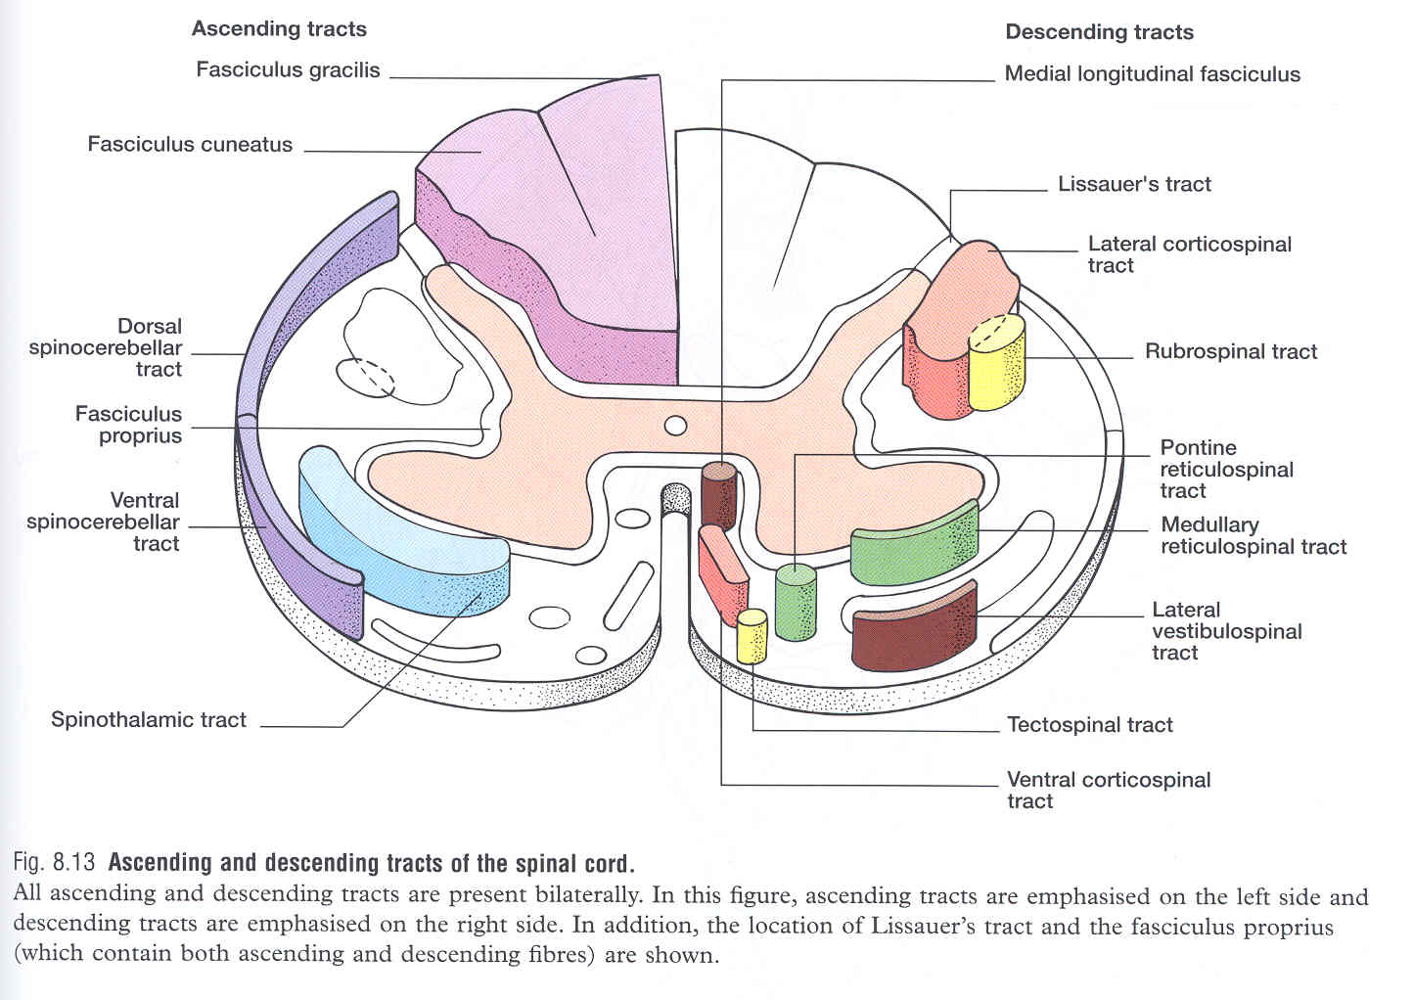
WHITE MATTER
Consists of mixture of nerve fibers, neuroglia and blood vessels.
White color is due to high proportion of myelinated nerve fibers
The white matter of the spinal cord is arranged in columns/funiculi; anterior, posterior and lateral.
The nerve fibers are arranged as bundles, running vertically through the cord.
A group of nerve fibers (axons) that share a common origin, termination and function form a tract or fasciculus
These tracts are formed by sensory nerve fibers ascending to the brain, motor nerve fibers descending from the brain and fibers of connector neurons.
Tracts are often named according to their points of origin and destination, e.g. spinothalamic, corticospinal.
Depending on their function, the spinal tracts are divided into ascending and descending tracts
Notes:
‹#›

Slide 24
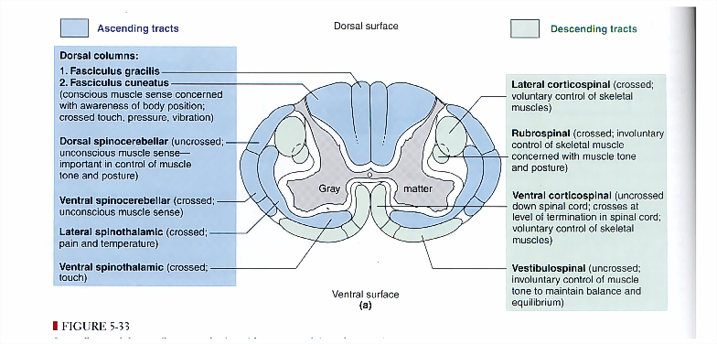
Notes:
‹#›

Slide 25
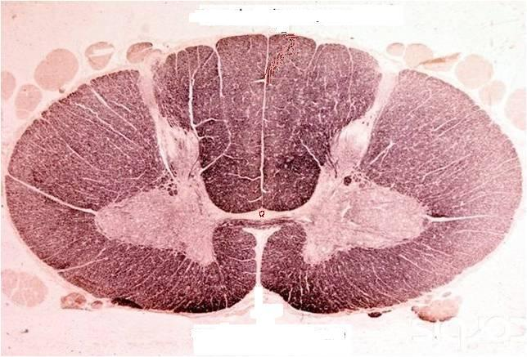
COMMISSURES OF THE SPINAL CORD
Grey Commissure:
Transverse bridge of grey matter connecting the anterior and posterior gray horns on each side
Is pierced by the central canal that divides it into anterior and posterior parts
White Commissure:
Lies ventral to the gray commissure
Mainly contains decussating nerve fibers
Notes:
‹#›

Slide 26
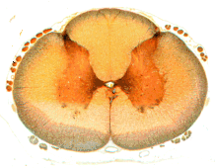
CENTRAL CANAL
The cerebrospinal-filled space that runs longitudinally through the entire length of the spinal cord.
Lined by ependyma (ciliated columnar epithelium)
Continuous with the ventricular system of the brain
Superiorly opens into the 4th ventricle
Inferiorly in the conus medullaris, it expands into the fusiform terminal ventricle and terminates below at the root of filum terminale
Notes:
‹#›

Slide 27
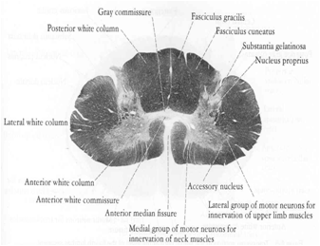
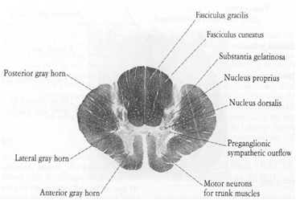
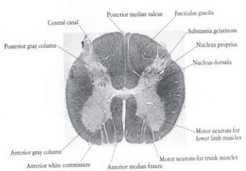
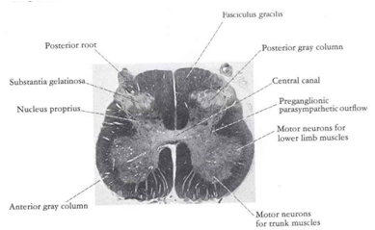
REGIONAL DIFFERENCES
Although the general pattern of gray matter is the same throughout spinal cord, regional differences are apparent in transverse sections
The amount of white matter increases in a caudal-to-cranial direction because fibers are added to ascending tracts and fibers leave descending tracts
The gray matter is in increased volume in cervical & lumbosacral enlargements for innervation of upper & lower limbs
The lateral horn is characteristics of thoracic and upper lumbar segments
Cervical
Thoracic
Lumbar
Sacral
Notes:
‹#›

Slide 28
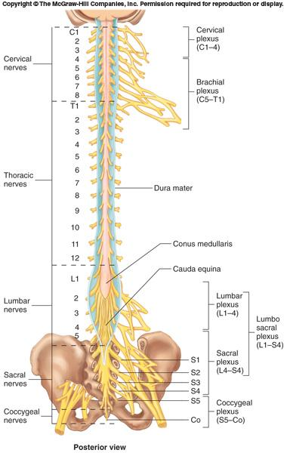
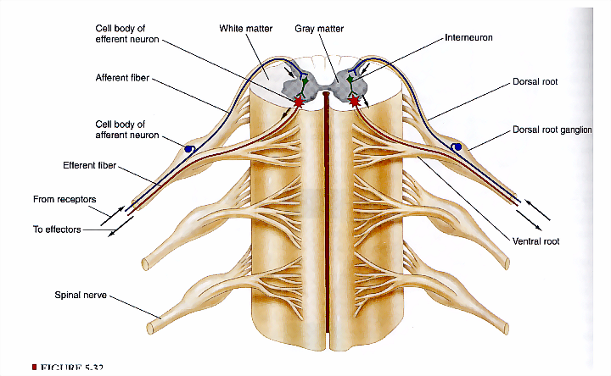
SPINAL NERVES
Thirty-one pairs of spinal nerves
First pair exit vertebral column between skull and atlas, last four pairs exit via the sacral foramina and others exit through intervertebral foramina
Eight pair cervical, twelve pair thoracic, five pair lumbar, five pair sacral, one pair coccygeal
Each spinal nerve arises as rootlets which then combine to form dorsal (posterior) & ventral (anterior) roots.
Two roots merge laterally and form the spinal nerve.
Dorsal (posterior) root has a ganglion (dorsal root/sensory ganglion) that contains the cell bodies of the sensory neurons
Each spinal nerve then divides into a smaller dorsal and a larger ventral ramus
Notes:
‹#›

Slide 29
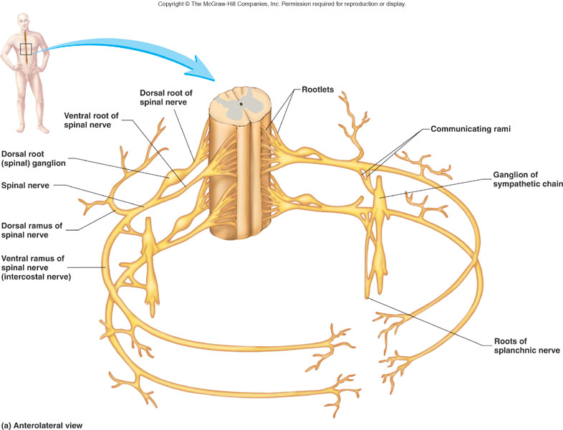
BRANCHES OF SPINAL NERVES
Dorsal Ramus: innervate deep muscles of the trunk responsible for movements of the vertebral column and skin near the midline of the back.
Ventral Ramus: what they innervate depends upon which part of the spinal cord is considered.
  Thoracic region: form intercostal nerves that innervate the intercostal muscles and the skin over the thorax
  Remaining spinal nerve ventral rami (roots of the plexus): form five plexuses (intermingling of nerves).
Ventral rami of C1-C4= cervical plexus
Ventral rami of C5-T1= brachial plexus
Ventral rami of L1-L5= lumbar plexus
Ventral rami of L4-S4= sacral plexus
Ventral rami of S4 & S5= coccygeal plexus
Communicating Rami: communicate with sympathetic chain of ganglia.
Notes:
‹#›

Slide 30
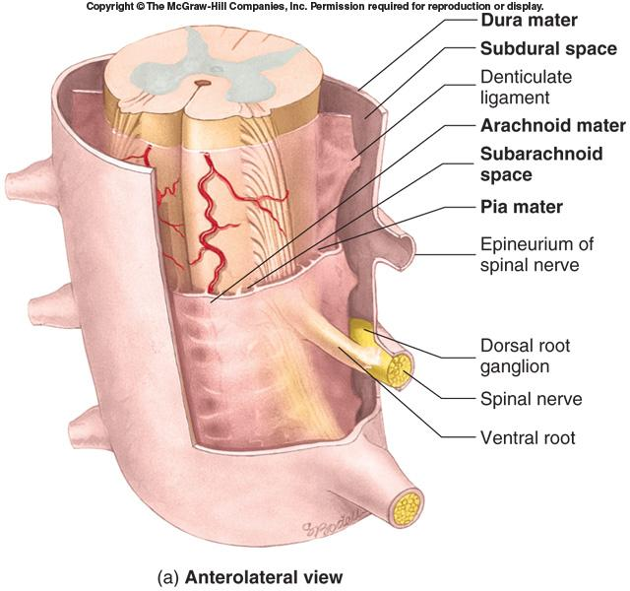
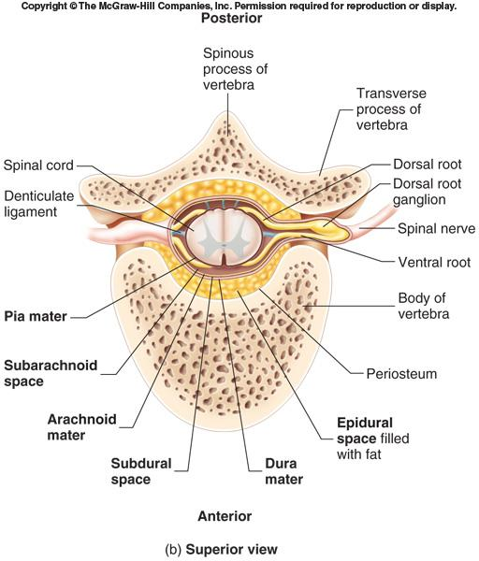
SPINAL MENINGES
Connective tissue membranes surrounding spinal cord and brain
  Dura mater: continuous with epineurium of the spinal nerves
  Arachnoid mater: thin and wispy
  Pia mater: bound tightly to surface of brain and spinal cord.
    Forms the filum terminale, which anchors spinal cord to coccyx and the denticulate ligaments that attach the spinal cord to the dura mater
Spaces
  Epidural: Contains blood vessels, connective tissue and fat.
  Subdural: Contains serous fluid
  Subarachnoid: Contains CSF and blood vessels within web-like strands of arachnoid tissue
Notes:
‹#›

Slide 31
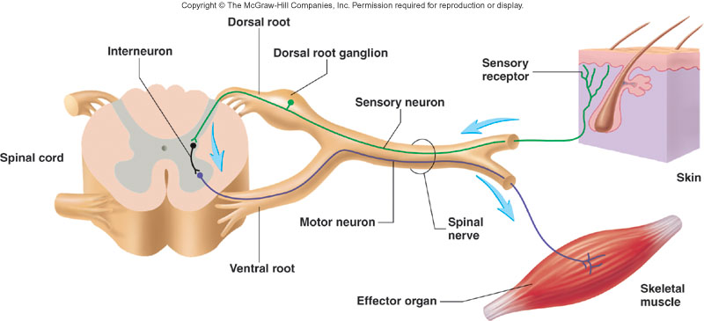
REFLEX & REFLEX ARC
A reflex is a rapid, involuntary, stereotyped pattern of response brought by a sensory stimulus
A neural pathway mediating the reflex actions is called reflex arc.
Notes:
‹#›

Slide 32
COMPONENTS OF A REFLEX ARC
  Action potentials produced in
Sensory receptor
Sensory neuron
  Effector organ which responds with a reflex
Motor neuron
Interneuron
Notes:
‹#›

Slide 33
QUESTIONS!
Notes:
‹#›

